Slide 1
SOFTWARE ENGINEERING
BY DONALD PHIRI

Slide 2
OUTLINE
Software
Relevance
Categories
Software Engineering
Why engineering
Software process
Adapting a process model
Software myths
How software is engineered (Case studies)

Slide 3
Software
The product that software professionals build and then support over the long term.
Software encompasses:
Instructions (computer programs) that when executed provide desired features, function, and performance.
Data structures that enable the programs to adequately store and manipulate information.
documentation that describes the operation and use of the programs.

Slide 4
Types
Generic Software: Stand-alone systems that are marketed and sold to any customer who wishes to buy them. Examples – PC software such as editing, graphics programs, project management tools; CAD software; software for specific markets such as appointments systems for dentists.
Customized products: Software that is commissioned by a specific customer to meet their own needs. Examples – embedded control systems, air traffic control software, traffic monitoring systems.

Slide 5
Software cost
Software costs often dominate computer system costs.
The costs of software on a PC are often greater than the hardware cost.
Software costs more to maintain than it does to develop.
For systems with a long life, maintenance costs may be several times development costs.
Software engineering is concerned with cost-effective software development.

Slide 6
Characteristic features
Its characteristics that make it different from other things human being build.
Features of such logical system: Software is developed or engineered, it is not manufactured in the classical sense which has quality problem.
Software doesn't "wear out.” but it deteriorates (due to change). Hardware has bathtub curve of failure rate ( high failure rate in the beginning, then drop to steady state, then cumulative effects of dust, vibration, abuse occurs).
Although the industry is moving toward component-based construction (e.g. standard screws and off-the-shelf integrated circuits), most software continues to be custom-built.
Modern reusable components encapsulate data and processing into software parts to be reused by different programs. E.g. graphical user interface, window, pull-down menus in library et

Slide 7
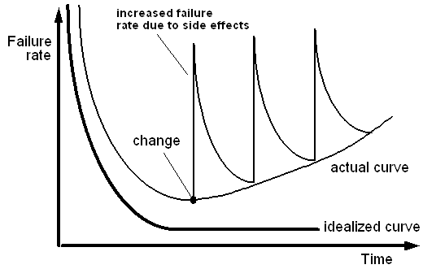
Pictorial view of software failure rate

Slide 8
Relevance
The economies of ALL developed nations are dependent on software.
More and more systems are software controlled ( transportation, medical, telecommunications, military, industrial, entertainment, banks, market platforms etc)
Software engineering is concerned with theories, methods and tools for professional software development.
Expenditure on software represents a significant fraction of GNP in all developed countries.

Slide 9
Categories
System software: such as compilers, editors, file management utilities.
Application software: stand-alone programs for specific needs.
Engineering/scientific software: Characterized by “number crunching "algorithms, such as automotive stress analysis, molecular biology, orbital dynamics etc.
Embedded software resides within a product or system. (key pad control of a microwave oven, digital function of dashboard display in a car).
Product-line software focus on a limited marketplace to address mass consumer market. (word processing, graphics, database management)
Web Apps (Web applications) network centric software. As web 2.0 emerges, more sophisticated computing environments is supported integrated with remote database and business applications.
AI software uses non-numerical algorithm to solve complex problem. Robotics, expert system, pattern recognition game playing

Slide 10
Software Engineering
The seminal definition:
Software engineering is the establishment and use of sound engineering principles in order to obtain economically software that is reliable and works efficiently on real machines.
The IEEE definition:
Software Engineering: The application of a systematic, disciplined, quantifiable approach to the development, operation, and maintenance of software; that is, the application of engineering to software.
Other sources:
Engineering is the application of an empirical, scientific approach to finding efficient, economic solutions to practical problems.

Slide 11
Why engineering not just production
More and more, individuals and society rely on advanced software systems.
We need to be able to produce reliable and trustworthy systems economically and quickly.
It is usually cheaper, in the long run, to use software engineering methods and techniques for software systems rather than just write the programs as if it was a personal programming project.
For most types of system, the majority of costs are the costs of changing the software after it has gone into use.
Issues of complexity, reusability, scalability are best handled by engineering approach.
When we get these things right, and many teams do, we see greater productivity, less stress and burnout in team members, higher quality in design, and more resilience in the systems that we create.

Slide 12
Continued
Engineering amplifies our ability to be creative, to make useful things, to proceed with confidence and quality. It allows us to explore ideas and ultimately to scale our ability to create things so that we can build ever bigger, more complex systems.
The systems that we build please their users more.
We see dramatically fewer bugs in production, and teams that employ these ideas find it significantly easier to change almost any aspect of the systems that they work on as their learning evolves.
Engineering is about learning and mastering.

Slide 13
Attributes of a good software
Maintainability and scalability: Software should be written in such a way so that it can evolve to meet the changing needs of customers. This is a critical attribute because software change is an inevitable requirement of a changing business environment.
Dependability and security: Software dependability includes a range of characteristics including reliability, security and safety. Dependable software should not cause physical or economic damage in the event of system failure. Malicious users should not be able to access or damage the system.
Efficiency: Software should not make wasteful use of system resources such as memory and processor cycles. Efficiency therefore includes responsiveness, processing time, memory utilisation, etc.
Acceptability: Software must be acceptable to the type of users for which it is designed. This means that it must be understandable, usable and compatible with other systems that they use.

Slide 14
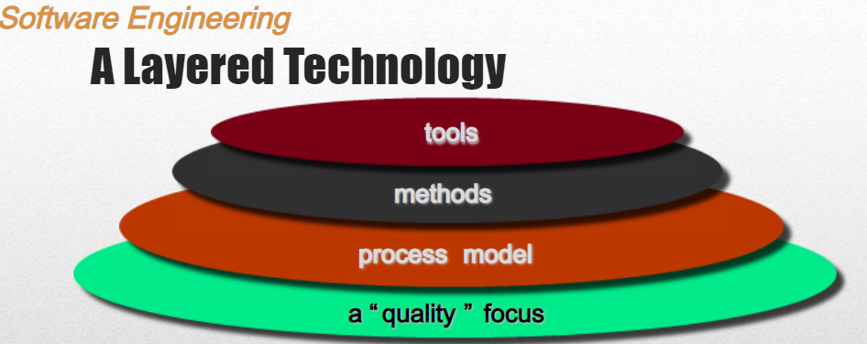
Software engineering layered model

Slide 15
Software engineering as a layered model.
Any engineering approach must rest on organizational commitment to quality which fosters a continuous process improvement culture.
Process layer as the foundation defines a framework with activities for effective delivery of software engineering technology. Establish the context where products (model, data, report, and forms) are produced, milestone are established, quality is ensured and change is managed.
Method provides technical how-tos for building software. It encompasses many tasks including: communication, requirement analysis, design modeling, program construction, testing and support.
Tools provide automated or semi-automated support for the process and methods.

Slide 16
Software process: how the journey starts
Starts with having any idea, new or already existing.
Need to change things.
Need to solve a problem related to software operations that affect business.
Need to extend the functions and features of an existing application.
Need to create a new product, service, or system.
Requires a road map, a process, a step by step approach. (software process)
Notes:
Every software project is precipitated by some business need—the need to correct a defect in an existing application;
the need to the need to adapt a ‘legacy system’ to a changing business environment;

Slide 17
Software process
A process is a collection of activities, actions and tasks that are performed when some work product is to be created.
It is not a rigid prescription for how to build computer software. Rather, it is an adaptable approach that enables the people doing the work to pick and choose the appropriate set of work actions and tasks.
Purpose of process is to deliver software in a timely manner and with sufficient quality to satisfy those who have sponsored its creation and those who will use it.

Slide 18
Five Activities of a Generic Process framework
Communication: communicate with customer to understand objectives and gather requirements.
Planning: creates a “map” defines the work by describing the tasks, risks and resources, work products and work schedule.
Modeling: Create a “sketch”, what it looks like architecturally, how the constituent parts fit together and other characteristics.
Construction: code generation and the testing.
Deployment: Delivered to the customer who evaluates the products and provides feedback based on the evaluation.
These five framework activities can be used to all software development regardless of the application domain, size of the project, complexity of the efforts etc, though the details will be different in each case. This will lead us to software development life cycle to be discussed later.
For many software projects, these framework activities are applied iteratively as a project progresses. Each iteration produces a software increment that provides a subset of overall software features and functionality.

Slide 19
Complement activities
Complement the five process framework activities and help team manage and control progress, quality, change, and risk.
Software project tracking and control: assess progress against the plan and take actions to maintain the schedule.
Risk management: assesses risks that may affect the outcome and quality.
Software quality assurance: defines and conduct activities to ensure quality.
Technical reviews: assesses work products to uncover and remove errors before going to the next activity.
Measurement: define and collects process, project, and product measures to ensure stakeholder’s needs are met.
Software configuration management: manage the effects of change throughout the software process.
Reusability management: defines criteria for work product reuse and establishes mechanism to achieve reusable components.

Slide 20
Adapting a Process Model
The process should be agile and adaptable to problems.
Process adopted for one project might be significantly different than a process adopted from another project. (to the problem, the project, the team, organizational culture). Among the differences are:
the overall flow of activities, actions, and tasks and the interdependencies among them
the degree to which actions and tasks are defined within each framework activity
the degree to which work products are identified and required
the manner in which quality assurance activities are applied
the manner in which project tracking and control activities are applied
the overall degree of detail and rigor with which the process is described
the degree to which the customer and other stakeholders are involved with the project
the level of autonomy given to the software team
the degree to which team organization and roles are prescribed

Slide 21
Prescriptive and Agile Process Models
The prescriptive process models stress detailed definition, identification, and application of process activaties and tasks.
Intent is to improve system quality, make projects more manageable, make delivery dates and costs more predictable, and guide teams of software engineers as they perform the work required to build a system.
Unfortunately, there have been times when these objectives were not achieved. If prescriptive models are applied dogmatically and without adaptation, they can increase the level of bureaucracy.
Agile process models emphasize project “agility” and follow a set of principles that lead to a more informal approach to software process. It emphasizes maneuverability and adaptability. It is particularly useful when Web applications are engineered.

Slide 22
Engineering meets software development
How does the practice of software engineering fit in the process activities mentioned above? Namely, communication, planning, modeling, construction and deployment.
George Polya outlines the essence of problem solving, suggests:
1. Understand the problem (communication and analysis).
2. Plan a solution (modeling and software design).
3. Carry out the plan (code generation).
4. Examine the result for accuracy (testing and quality assurance).

Slide 23
Understand the Problem: where mostly things go wrong
Who has a stake in the solution to the problem? That is, who are the stakeholders?
What are the unknowns?
What data, functions, and features are required to properly solve the problem?
Can the problem be compartmentalized?
Is it possible to represent smaller problems that may be easier to understand?
Can the problem be represented graphically?
Can an analysis model be created?
Is it a new invention or an update or an upgrade?
Notes:
Failure to understand what you want to build leads to poor software projects

Slide 24
Understand the Problem: where mostly things go wrong
Have you seen similar problems before?
Are there patterns that are recognizable in a potential solution? Is there existing software that implements the data, functions, and features that are required?
Has a similar problem been solved? If so, are elements of the solution reusable?
Can sub problems be defined?
If so, are solutions readily apparent for the sub problems?
Can you represent a solution in a manner that leads to effective implementation?
Can a design model be created?
Plan the Solution

Slide 25
Hooker’s General Principles for Software Engineering Practice: important underlying law
1: The Reason It All Exists: provide values to users
2: KISS (Keep It Simple, Stupid! As simple as possible)
3: Maintain the Vision (otherwise, incompatible design)
4: What You Produce, Others Will Consume (code with concern for those that must maintain and extend the system)
5: Be Open to the Future (never design yourself into a corner as specification and hardware changes)
6: Plan Ahead for Reuse
7: Think! Place clear complete thought before action produces better results.

Slide 26
Software Myths
Erroneous beliefs about software and the process that is used to build it.
Affect managers, customers (and other non-technical stakeholders) and practitioners
Are believable because they often have elements of truth, but …Invariably lead to bad decisions, therefore …Insist on reality as you navigate your way through software engineering

Slide 27
Software Myths Examples
Myth 1: Once we write the program and get it to work, our job is done. Reality: the sooner you begin writing code, the longer it will take you to get done. 60% to 80% of all efforts are spent after software is delivered to the customer for the first time.
Myth 2: Until I get the program running, I have no way of assessing its quality. Reality: technical review are a quality filter that can be used to find certain classes of software defects from the inception of a project.
Myth 3: software engineering will make us create voluminous and unnecessary documentation and will invariably slow us down. Reality: it is not about creating documents. It is about creating a quality product. Better quality leads to a reduced rework. Reduced work results in faster delivery times.
Many people recognize the fallacy of the myths. Regrettably, habitual attitudes and methods foster poor management and technical practices, even when reality dictates a better approach.

